Slide 1

ONLINE COMPILER USING CLOUD COMPUTING
Computer Science Project I – CS691
Anchal Singh
Ramesh Kyasaram
Tushar Rakholiya
Sanath Gholap
Harshada Chaudhari

Slide 2
INTRODUCTION
In today’s fast and competitive world everything is available on internet, and on web. So, we developed an online compiler using cloud computing. The main objective of this project is to develop a centralized compiler that helps to reduce problems like portability storage, cost, and space.
It is the most convenient tool to compile code, remove errors and debug code. Moreover, we can run the web-based application remotely from any network connection that is independent of platform. The challenge of installing a compiler on each machine is also avoided and therefore, these all benefits make this application suitable of cloud based online compiler make it suitable for performing online exams.

Slide 3

PERSONA
I am John pursuing Master’s from a well-known university. Being a Graduate student in Computer Science, writing and compiling codes in different languages is part of our daily life. Sometimes we find it difficult to get the subscription for different compiler because it’s costly and it will become more costly if we are taking subscription for different compiler for each coding languages.
Therefore, we yearn for a single platform where we can compile at least more frequently used languages (Java, Python, C#, C, C++) at the same platform by making the coder’s life easier.

Slide 4
MODULES & PHASES
Modules
Registration
Login
3. Code :-
1) Enter source code
2) Compile
3) Save
Phases
Technology Research
Gathering Requirements
Requirement Analysis
Implementation
User Experience
Deployment

Slide 5
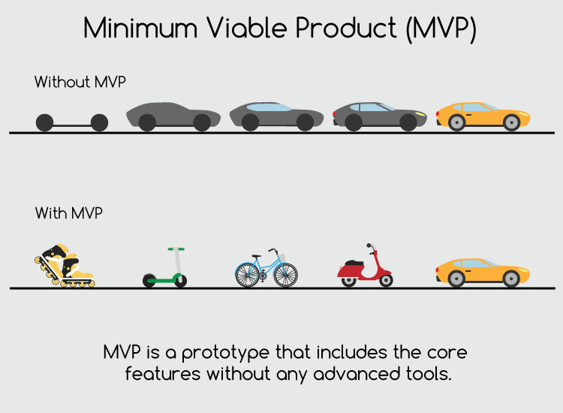
MVP
Which Problem does it solve!
It can be hectic for students or working professionals to download IDEs and virtual machines for individual languages to run their programs in very short amount of time.
Minimum :- An application which can compile or debug the code and get the desired output.
Viable : An online platform for everyone where anyone can run the code in any of the given programming languages with features like save the source code.
Minimum + Viable :- We are presenting a product which is based on cloud computing with features like login, registration with authentication and compilation of source code.

Slide 6
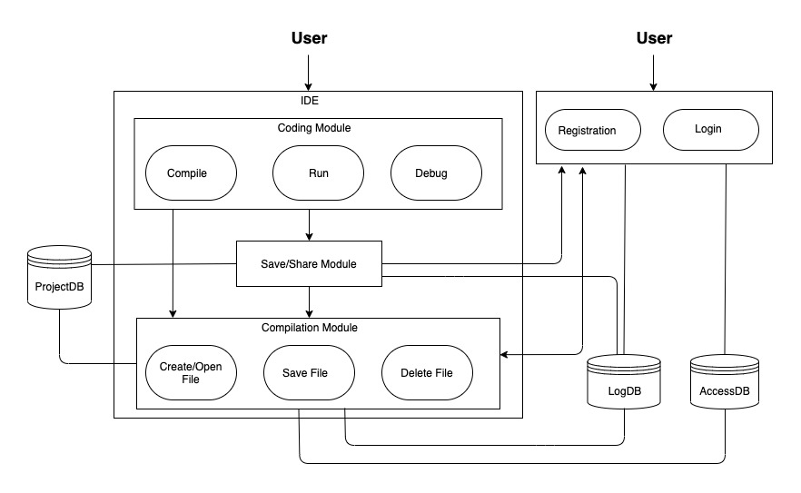
SYSTEM ARCHITECTURE

Slide 7
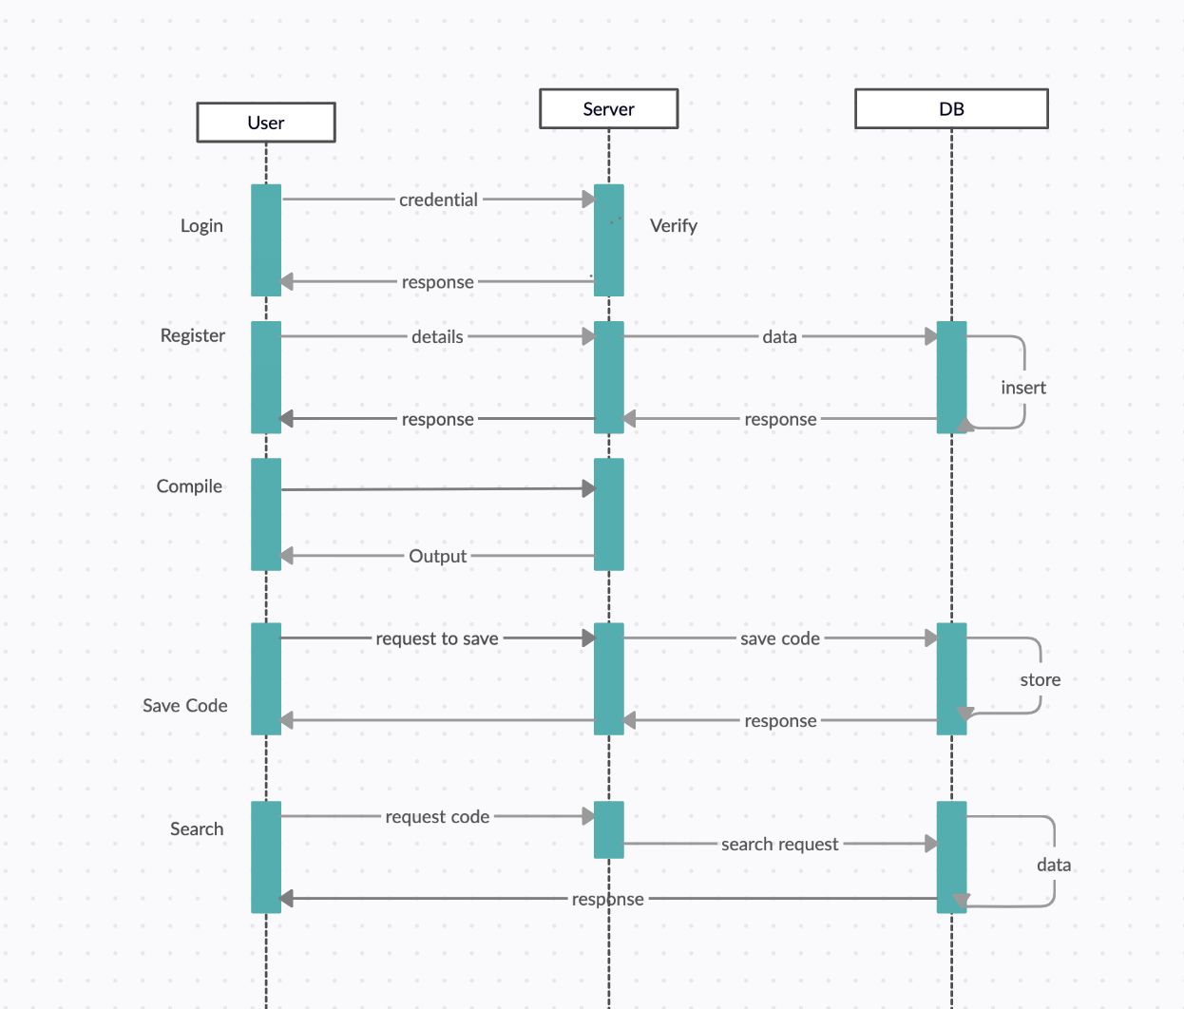
SEQUENCE DIAGRAM

Slide 8
PRODUCT BACKLOG
ID | Features | As a | I want to | So that | Priority
1 | User Registration | User | Enter login details that is the first and last name, e-mail and password. | I can create my profile and register myself on the cloud computing service. | High
2 | Login | User | Enter registered e-mail and password. | I can authenticate my account and after that I can retrieve previously stored source code. | High
3 | Compilers for C, C++, C#, Java and Python | User | Select any of the compilers from the drop-down menu. | I can compile the code in any of the programming languages. | Moderate
4 | Compile the code | User | Write or paste the source code in the “Enter your code” text area and compile it by clicking on the “Run” button. | I can compile and test my source code. | High
5 | Save the Code | User | Save the code by clicking on the “Save” button. | So that I can store my source code and view it whenever I login using my credentials. | Moderate

Slide 9
ACCEPTANCE CRITERIA
ID | Features | As a | Acceptance Criteria
1 | User Registration | User | 1. Display Website. 2. Display Register or sign in option. 3. A user cannot register without completing all mandatory fields. 4. Information from the form is stored in the registration database. 5. Existing user cannot register again. 6. Commencement and maintaining the session while logged in. 7. Triggers session termination.
2 | Login | User | 1. Login with username/e-mail. 2. Enter password. 3. Forgot username/password.
3 | Compilers for C, C++, C#, Java and Python | User | 1. Display a drop-down menu of the programming languages. 2. Display two text areas for entering the source code and for viewing output/error of the code.
4 | Compile the code | User | 1. Display a run button. 2. Programming language should be selected by user from the drop-down menu. 3. There should be code written by the user in the "Enter your code" text area.
5 | Save the Code | User | 1. The user must me registered and logged in in-order to use the save feature. 2. Display "Save" button. 3. The programming language should be selected and there should be a code written by the user in the source code area.

Slide 10
TEST CASES
Test Cases for | Test Case ID | Test Scenario | Test Data | Expected Results | Actual Results | Pass/Fail
Registration | 1 | Check registration form with First name | Sanath | NO Validation Errors | NO Validation Errors | PASS
 | 2 | Check registration form without first name | *Blank* | Validation Errors | Validation Errors | PASS
 | 2 | Check registration form with Last name | Gholap | NO Validation Errors | NO Validation Errors | PASS
 | 4 | Check registration form without Last name | *Blank* | Validation Errors | Validation Errors | PASS
 | 5 | Check registration form with vaild email | sanath2097@gmail.com | NO Validation Errors | NO Validation Errors | PASS
 | 6 | Check registration form without email | *Blank* | Validation Errors | Validation Errors | PASS
 | 7 | Check registration form with Password | testpassword | NO Validation Errors | NO Validation Errors | PASS
 | 8 | Check registration form without Password | *Blank* | Validation Errors | Validation Errors | PASS
 | 9 | Check registration form with invalid email | sanathgholap.com | Validation Errors | Validation Errors | PASS
 | 10 | Check registration form with confirming Password | *Wrong password in confirm field* | NO Validation Errors | NO Validation Errors | PASS
Login | 11 | Check Login page with Password | testpassword | NO Validation Errors | NO Validation Errors | PASS
 | 12 | Check Login page without Password | *Blank* | Validation Errors | Validation Errors | PASS
 | 13 | Registration with pre-registered e-mail ID | sanath2097@gmail.com | User Already Exsists Error | User Already Exsists Error | PASS
Compile | 14 | Choosing the language from the drop-down menu with selecting a language | Java/Python/C/C++/C# | NO Validation Errors | NO Validation Errors | PASS
 | 15 | Choosing the language from the drop-down menu without selecting a language | *Blank* | Validation Errors | Validation Errors | PASS
 | 16 | Enter source code in the text area with entering text | Any code | NO Validation Errors | NO Validation Errors | PASS
 | 17 | Enter source code in the text area without entering text | *Blank* | Validation Errors | Validation Errors | PASS
Save | 18 | Check if the source code text area contains code with actual code | Any code | NO Validation Errors | NO Validation Errors | PASS
 | 19 | Check if the source code text area contains code without actual code | *Blank* | Validation Errors | Validation Errors | PASS

Slide 11

TECHNOLOGIES USED
Google Cloud Platform
Python(Flask) (Middleware Business Logic)
HTML/CSS (Front-end)
MongoDB (Database)

Slide 12

SPRINTS
Sprint 1
Sprint 2
Sprint 3
Sprint 4

Slide 13
SPRINT 1
Sprint 1
Sprint 2
Sprint 3
Sprint 4
Researched about the technologies that can be related to the project
Decided on who will work on which module.

Slide 14
SPRINT BACKLOG
Sprint Task | Module | Priority | Issues Encountered | Start Date | End Date | Status
Sprint 1 : Task 1 | Database | High | We cannot use structured database | 09/04/2020 | 09/18/2020 | Completed
Sprint 1 : Task 2 | Cloud Service | High | Decision of selecting the cloud and storage service depending upon the cost and usage. | 09/07/2020 |  | In-Progress

Slide 15
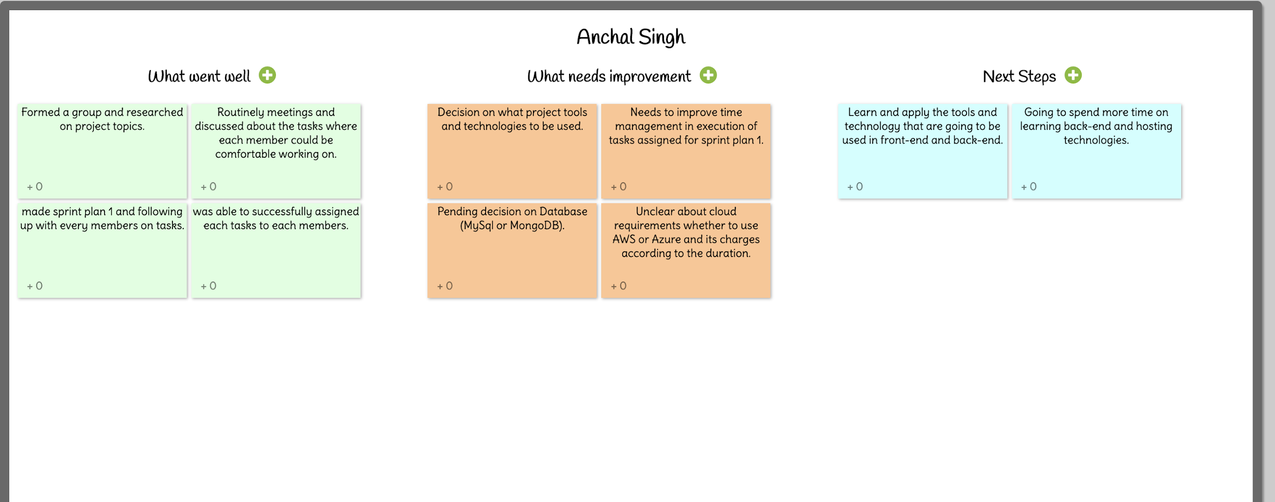
RETROSPECTIVE SPRINT 1

Slide 16
SPRINT 2
Sprint 1
Sprint 2
Sprint 3
Sprint 4
Selection and learning about web application technology.
Learning about compatibility of database.
Started initial development of web application.

Slide 17
SPRINT BACKLOG
Sprint Task | Module | Priority | Issues Encountered | Start Date | End Date | Status
Sprint 2 : Task 1 | Web Application | Medium | Selecting the layout of the front-end | 09/23/2020 | 10/02/2020 | Completed

Slide 18
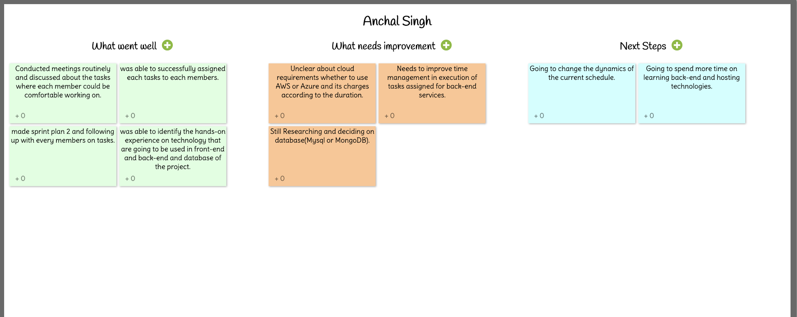
RETROSPECTIVE SPRINT 2

Slide 19
SPRINT 3
Sprint 1
Sprint 2
Sprint 3
Sprint 4
Researched and experimented on subprocess module of Python for compiler.
Developed the frontend for compiler module.
Developed the module for saving the source code.

Slide 20
SPRINT BACKLOG
Sprint Task | Module | Priority | Issues Encountered | Start Date | End Date | Status
Sprint 3 : Task 1 | Compiler | High | Cannot take string as an argument for execution. | 10/06/2020 |  | In-Progress
Sprint 3 : Task 2 | Compiler | High | Source code cannot take any input. | 10/06/2020 |  | In-Progress
Sprint 3 : Task 3 | Save | Low | Connection between database and web application has not been established. | 10/15/2020 |  | In-Progress

Slide 21
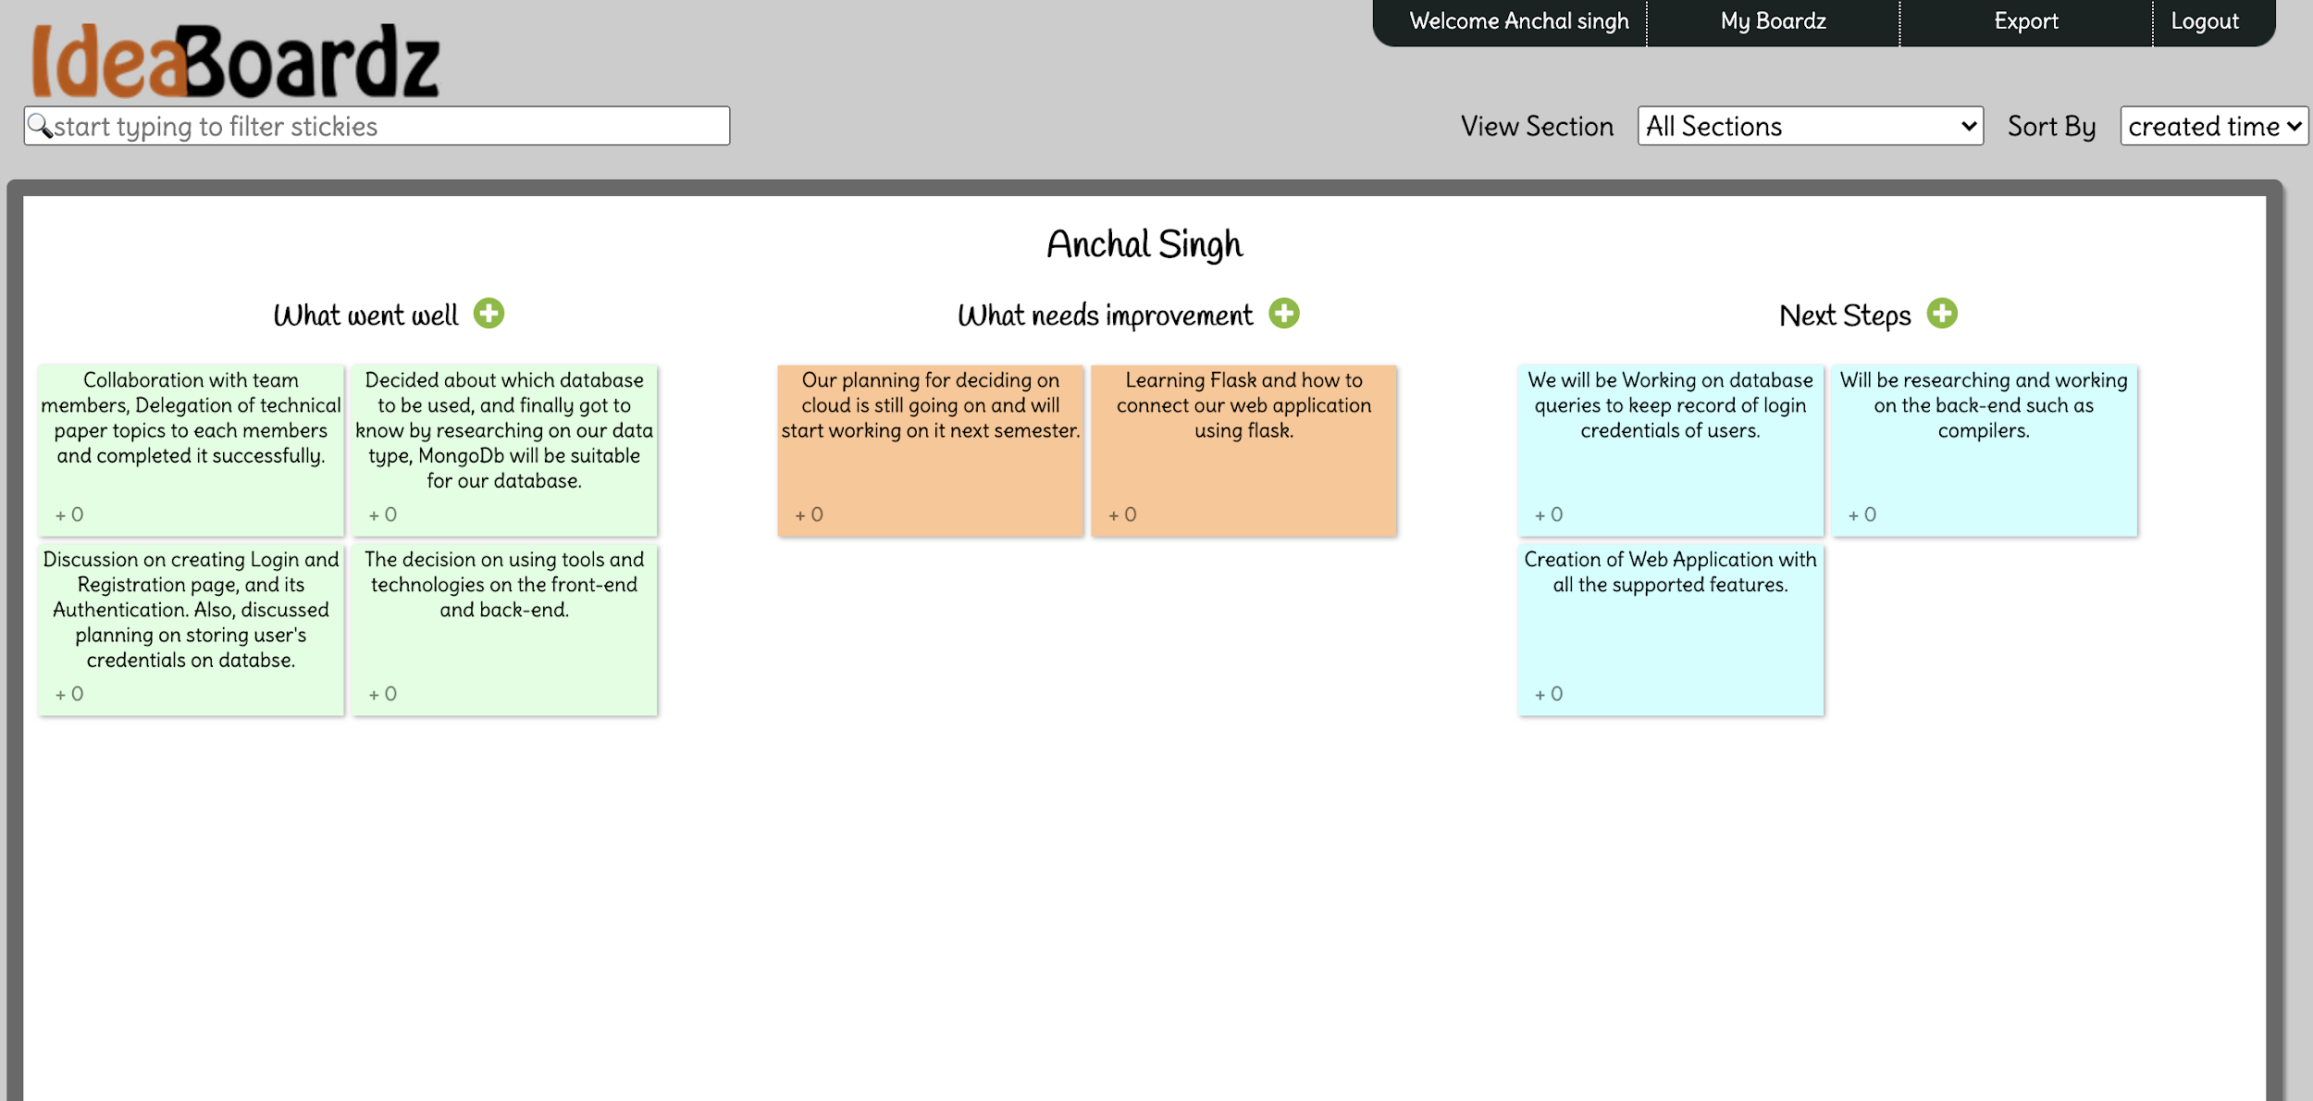
RETROSPECTIVE SPRINT 3

Slide 22
SPRINT 4
Sprint 1
Sprint 2
Sprint 3
Sprint 4
Developed the registration and login module with authentication.
Created tables in MongoDB for registration and login.
Created Integrated APIs for web application.

Slide 23
SPRINT BACKLOG
Sprint Task | Module | Priority | Issues Encountered | Start Date | End Date | Status
Sprint 4 : Task 1 | API | Medium | Update of Rest API is not working. | 10/28/2020 |  | In-Progress
Sprint 4 : Task 2 | Database | Medium | Aggregation of user table is not working. | 10/30/2020 | 11/15/2020 | Completed
Sprint 4 : Task 3 | Login and Database | High | Not able to store user information in session for further functioning of application | 11/02/2020 | 11/20/2020 | Completed
Sprint 4 : Task 4 | Registration | High | Cannot encode the password using secret key in Python | 11/09/2020 | 11/16/2020 | Completed

Slide 24
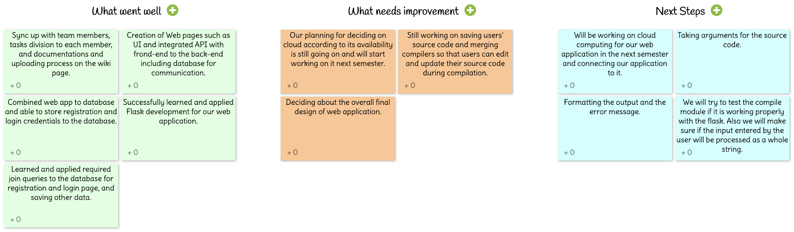
RETROSPECTIVE SPRINT 4

Slide 25

SCRUM MEETINGS
The format of our daily scrum meetings consist of 3 main points :
What did you do yesterday?
What is the plan for today?
How close we are to reaching our sprint objectives?

Slide 26

FUTURE SCOPE
We can add a discussion area where registered users can help each other with their difficulties in the code.
We can update our web application to make it more user friendly.
We can expand our application for compiling various other programming languages.
Implement strict privacy for user's data safety.

Slide 27

GITHUB LINK
https://github.com/sg99356n/OnlineCC/wiki/Online-Compiler-Using-Cloud-Computing

Slide 28
THANK YOU!

